Slide 1




Health happens now. Take action to stay healthy with our personalized genetic reports
By:
1.Faliha Zikra
2.Mytreyi Reddy
3.Sri Ananya Kondiparthy
4.Apoorva Revankar

Slide 2
Our website
https://mreddy03.wixsite.com/website

Slide 3
Agenda
Introduction
Business Requirements
Context Diagram
Future Work
Conclusion
Appendix

Slide 4
About Know Your DNA
KnowYourDNA provides a direct-to-consumer genetic testing service in which customers provide a saliva sample that is laboratory analyzed. It helps people access and understand their genome better by offering advanced DNA reports that deliver :
An Enriching view of a person’s ancestry that helps discover their family history.
In-depth information about genetic predispositions to health risks, wellness, and physical traits.
Customers have a choice to share this information with their primary healthcare provider who is then able to:
Suggest lifestyle changes for a better outcome.
Order more tests for further screening, if needed.

Slide 5
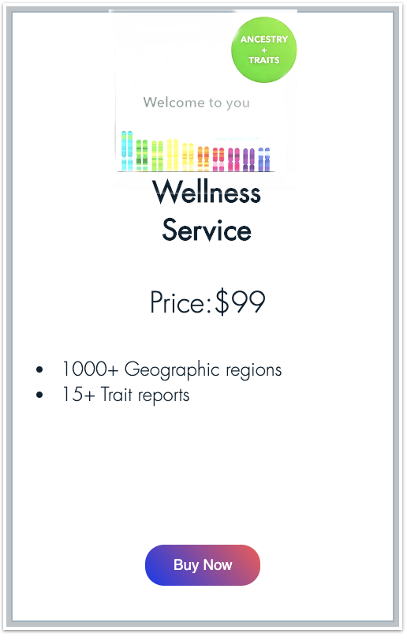

Our Products
Carrier status of 25 inherited conditions
25 physical traits
7 wellness genes
Includes Wellness Service PLUS
600+ geographic regions
Notes:
carrier status of 25 inherited conditions and how their genetics can influence their chances of developing certain conditions,
how their DNA influences 25 physical traits,
how 7 genes play a role in their well- being and lifestyle choices, and
where their DNA is from out of 600+ regions worldwide.

Slide 6
Our process is easy
View your reports in less than a week
03
Order registration Kit from the KnowyourDNA website.
01
02
Send your DNA sample

Slide 7
we ship to…
Our office

Slide 8
Business Need
KnowYourDNA sequences key information from the customer’s DNA and maps it to prior ancestral databases as a commercial service to the end-user via a web interface.
Other services that provide ancestry and wellness information. are caught up in legalities due to FDA regulations and are unable to provide “not- sugar-coated” findings to their customers.
The Rockstar feature of our application is that we can link the user’s primary care physician to view their test results and/or they can recommend tests or therapy routes to the users

Slide 9
> An electronic record of the user’s genetic makeup that can be reviewed anytime by the user or his physician.
> Improve users’ awareness and understanding of their DNA and its risk implications which helps them make more informed choices.
> Comprehensive genetic testing highlights health risks that might help with early-on detection of risks.
Business Value
Notes:
An electronic record of the user’s genetic makeup that can be reviewed anytime by the user or his physician.
It helps improve users’ awareness and understanding of their DNA and its risk implications which helps them make more informed choices that may relate to healthy living.
Comprehensive genetic testing highlights health risks that might help with early-on detection of risks which otherwise might not surface for years, therefore improving user’s health outcomes by 15%.

Slide 10
Outcomes
> Improving user’s health outcomes by 15%.
> 18% increase in proactive communication between physician and user regarding health risks.
> Encourages lifestyle changes and preventative measures prior to the incidence of health risks by 15 to 20%.
Notes:
Comprehensive genetic testing highlights health risks that might help with early-on detection of risks which otherwise might not surface for years, therefore improving user’s health outcomes by 15%.
Improves early-on communication and interaction between the user and their primary care physician proactively which helps educate the user further.
Encourages lifestyle changes and preventative measures prior to the incidence of health risks by 15 to 20%.

Slide 11
Business Requirements

Slide 12
Business Requirement 1
The system should allow the customer to order a kit.
The system should allow the customer to select from Wellness or Ancestry and Wellness kits.
The system should allow the customer to enter their the shipping address.
The system should allow the customer to enter their payment information and checkout the kit
The system should update the order details in the Order Data Store, after payment.

Slide 13
Business Requirement 2
The system should allow the processing of the order by the Clerk and Geneticist .
The system should allow the clerk to generate a UPS tracking number for shipping.
The system should allow the clerk to update the order information with the tracking number.
The system should display the list of up- to date traits that the geneticist should analyze the sample for.
The system should allow the geneticist to update the wellness information in the Wellness Data Store.
Notes:
c

Slide 14
Business Requirement 3
The system should display a personalized user dashboard for the customer
The system should allow customers to select and view either their ancestry, wellness or statistical information.
The system should allow customer to add his physician into his profile account.
The system should prompt the customer to grant permission to use their payment details.
The system should update the customer order with the physician’s details.

Slide 15
Business Requirement 4
The system should display a personalized user dashboard for the physician
The system should allow physician to choose the patient whose report they want to view.
The system should allow Physicians to access the patient’s personalized report.
The system should allow physician to order more tests for his patient from a list of tests.
The system should display results of the additional tests ordered by physician.

Slide 16
Physician Dashboard
https://mreddy03.wixsite.com/website

Slide 17
Context Diagram

Slide 18
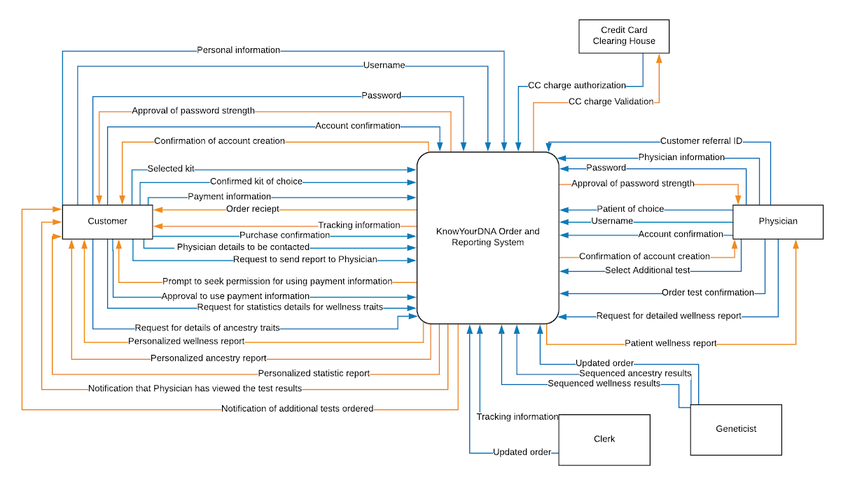

Slide 19
Future Scope

Slide 20
Future Work
Physician
30 Additional Tests to order from
Research Program 2023
Customer
Ancestry
50 Additional Test for rare cancers
DNA Relative Finder
Tree Builder
Notes:
As a next step, on the wellness and health front, we would like to add 50 additional variant testing capability which would cover biomarkers for rare carcinomas and immunological diseases such as giant cell arteritis, where the patient’s disease progression might take years and goes undiagnosed eventually leading to loss of vision or worse symptoms. Hence in such cases, early detection is crucial.
On the ancestry front, we would also like to give customers an option to connect with people who share DNA with them through the ‘DNA Relative Finder’ feature. Customers can also create family trees with the ‘Tree Builder’ feature. In addition to this, customers will be able to trace parts of their ancestry to a specific group of individuals from 1,000+ years ago and learn about which civilizations their forefather descended from.
We also plan aiding the physician help their patients better, and hence plan on adding 30 additional biomarker tests that the physicians can order. This helps keep the customer’s test and genetic health records on one single portal which would facilitate easy access for the customers and their physicians. We believe that having a comprehensive and complete understanding of the customer’s biomarker profile will prevent the progression of some serious conditions.
By 2023, we plan to partner with several research facilities that conduct genetic research. Customers can opt into our research program that can help drive scientific and medical discoveries. This kind of genetic research gives everyday people the opportunity to make a difference. Researchers would link the customer’s genetic data to study topics from ancestry, to traits, to disease which can accelerate research and would help answer some scientific mysteries and solve for unmet medical needs.

Slide 21
Conclusion

Slide 22
Conclusion
KnowYourDNA analyzes customer’s saliva sample with our in house testing capabilities against :
25 genetic traits for health conditions such as Breast cancer, Coronary heart disease and how their results compare to the rest of the population.
25 physical traits such as eye Color, Freckles
7 wellness traits such as Deep Sleep, Lactose Intolerance
600+ geographic regions to map ancestry information
This 360 degree view into their genetic profile gives customers a comprehensive understanding for themselves.
‘Send Report to Physician’ functionality has help improved patient outcomes by promoting better lifestyle choices and early diagnosis of chronic conditions.

Slide 23
Thanks!
Any questions?

Slide 24
Appendix

Slide 25
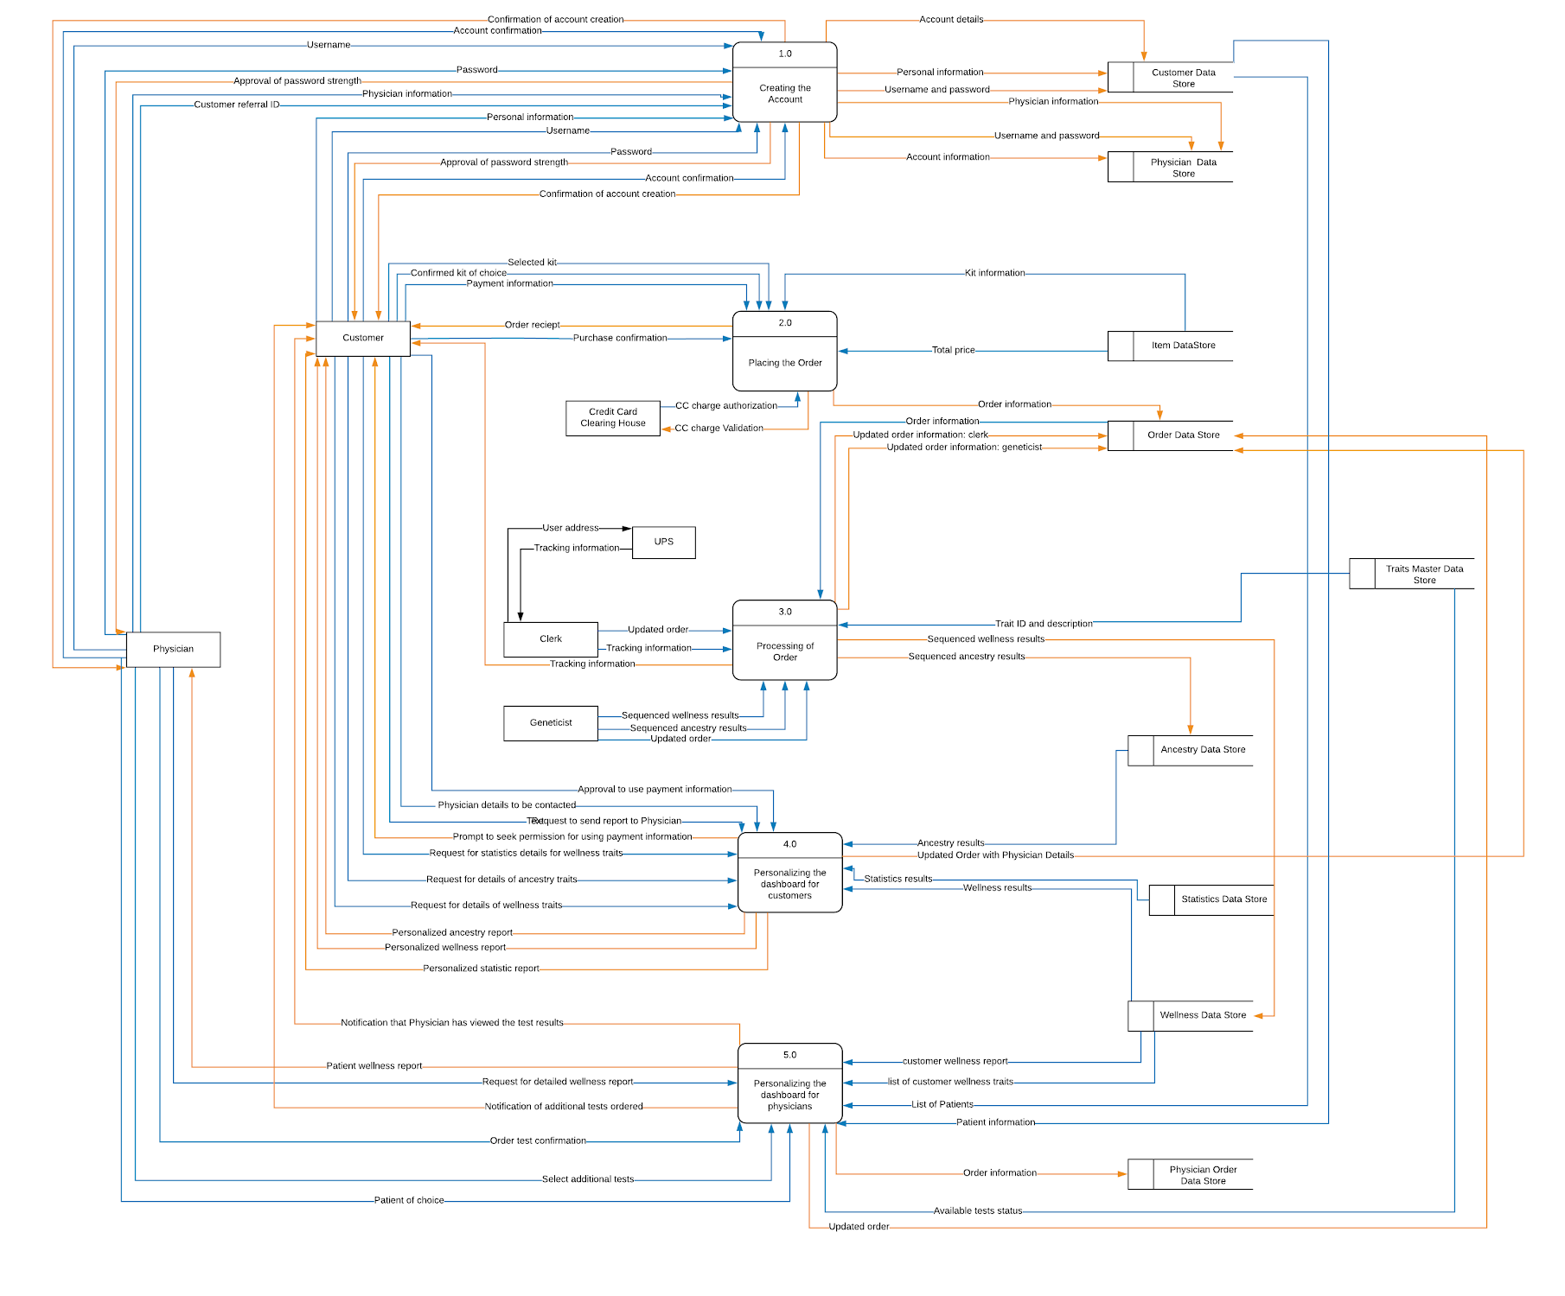
Level 0

Slide 26
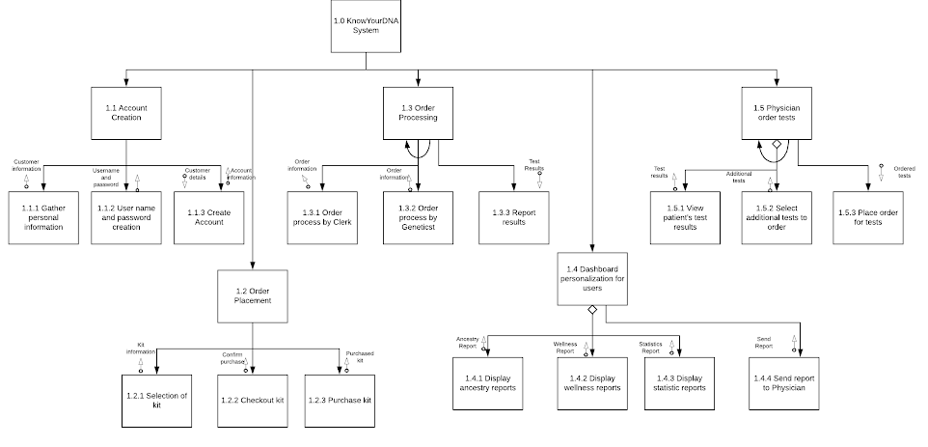
Structure Chart

